Slide 1
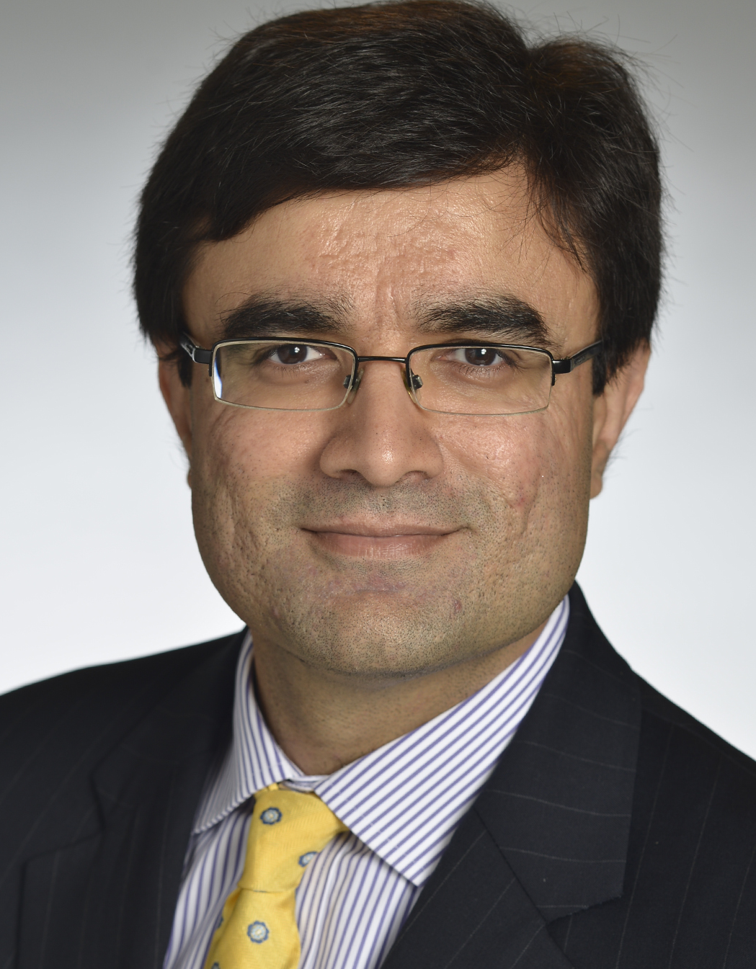

Navatar Webinar:
HOW TO ‘MONEYBALL’ YOUR PRIVATE EQUITY DEAL SOURCING
November 30th, 2017, 1pm EST (5 pm GMT)
Featuring Nadim Malik
CEO of Sutton Place Strategies

Slide 2








#1 PRIVATE MARKETS PLATFORM
Navatar is the #1 global cloud software provider to the private capital community, including alternative asset firms, middle market intermediaries and strategic buyers worldwide.
600+ customers in 35+ countries
100% SaaS - Built on Salesforce & Box clouds
US, Europe and Asia offices
Founded in 2004

Slide 3








Pairing actionable data with proprietary analytics
SPS is an award winning provider of actionable data and analytics for PE and M&A professionals to optimize their business development and deal sourcing efforts.
Founded in 2009 by PE business development professionals
100+ clients across the Private Equity, Lending, and M&A universe
Built and headquartered in New York
Powerful online tools and reports focused exclusively on deal sourcing

Slide 4

DEAL SOURCING – AN EVOLUTION
01
Proactive vs. Reactive

Slide 5
SPONSOR DEAL FLOW + M&A ACTIVITY
*Deals closed in North America, $10+ MM in transaction value, with a private equity or corporate investor.
**Average of last four quarters' dealflow for a PE firm (average of 90+ firms).

Slide 6
DEAL SOURCING – AN EVOLUTION
01
Proactive vs. Reactive
02
Rise of the BD Professional
03
Technology
04
Data and Analytics

Slide 7
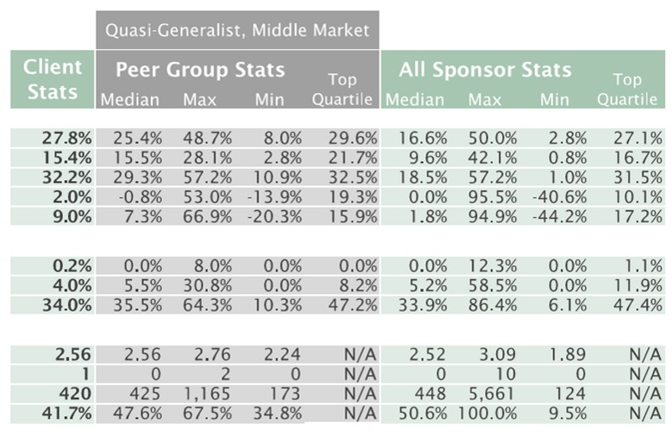
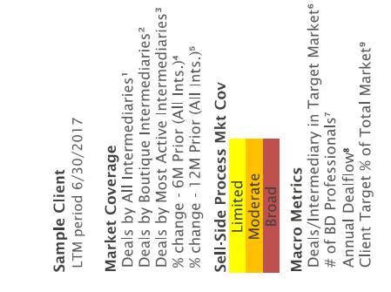
DEAL SOURCING METRICS – MONEYBALL!
*Percentage of a completed PE transactions with a sell-side advisor in relevant size ranges and sectors reviewed by a PE firm.

Slide 8
DEAL SOURCING – TIPS & TOOLS FOR SUCCESS
  Focusing on intermediaries that run more limited process (SPS Sell-Side Process Index)

Slide 9
INTERMEDIARY OPPORTUNITIES – A BREAKDOWN
Firm | City | State | # of Deals | % of Total | Cumulative % of Total
Houlihan Lokey | Los Angeles | CA | 109 | 3.0% | 3.0%
Goldman Sachs | New York | NY | 90 | 2.5% | 5.5%
Raymond James | St. Petersburg | FL | 78 | 2.2% | 7.7%
J.P. Morgan Chase | New York | NY | 77 | 2.1% | 9.8%
William Blair & Co. | Chicago | IL | 62 | 1.7% | 11.6%
Jefferies & Co. | New York | NY | 61 | 1.7% | 13.3%
Morgan Stanley | New York | NY | 59 | 1.6% | 14.9%
Robert W. Baird | Milwaukee | WI | 57 | 1.6% | 16.5%
Evercore Partners | New York | NY | 54 | 1.5% | 18.0%
Piper Jaffray & Co. | Minneapolis | MN | 52 | 1.4% | 19.4%
Lincoln International | Chicago | IL | 50 | 1.4% | 20.8%
Moelis & Company | New York | NY | 48 | 1.3% | 22.2%
Bank of America Merrill Lynch | New York | NY | 45 | 1.3% | 23.4%
Harris Williams | Richmond | VA | 44 | 1.2% | 24.6%
Credit Suisse | New York | NY | 41 | 1.1% | 25.8%
Generational Equity | Dallas | TX | 41 | 1.1% | 26.9%
RBC Capital Markets | Toronto | CAN | 36 | 1.0% | 27.9%
Sandler O'Neill & Partners | New York | NY | 36 | 1.0% | 28.9%
Lazard | New York | NY | 35 | 1.0% | 29.9%
BMO Capital Markets | New York | NY | 32 | 0.9% | 30.8%
Wells Fargo Securities | San Francisco | CA | 31 | 0.9% | 31.6%
# of Firms |  | # of Deals | % of Total | Cumulative % of Total
9 | Completed 20-29 Deals | 214 | 5.9% | 37.6%
17 | Completed 15-19 Deals | 291 | 8.1% | 45.7%
34 | Completed 10-14 Deals | 391 | 10.9% | 56.5%
85 | Completed 5-9 Deals | 550 | 15.3% | 71.8%
47 | Completed 4 Deals | 188 | 5.2% | 77.0%
77 | Completed 3 Deals | 231 | 6.4% | 83.5%
130 | Completed 2 Deals | 260 | 7.2% | 90.7%
335 | Completed 1 Deal | 335 | 9.3% | 100.0%
 | Totals** | 3,598 | 100.0%
Out of 755 Active Intermediaries,
72% (542) Completed
Three Deals or Less
*Includes PE and M&A transactions completed in LTM Sept 2017, $10+ MM in transaction value, with a confirmed intermediary.
**Total exceeds actual number of deals closed due to multiple intermediaries on some transactions.

Slide 10
DEAL SOURCING – TIPS & TOOLS FOR SUCCESS
  Focusing on intermediaries that run more limited process (SPS Sell-Side Process Index)
  Reaching out to new deal sources in a time manner
  Bringing your deal pipeline to life for broken deals
  Understanding the closing rate of your intermediaries

Slide 11
DEMO

Slide 12


QUESTIONS – GET IN TOUCH!
Nadim Malik
Email: NMalik@suttonplacestrategies.com
Phone: 646-418-2995
Nicholas Donato
Email: ndonato@navatargroup.com
Phone: 212-863-9655 X 3662
ACG Rep

